Slide 1
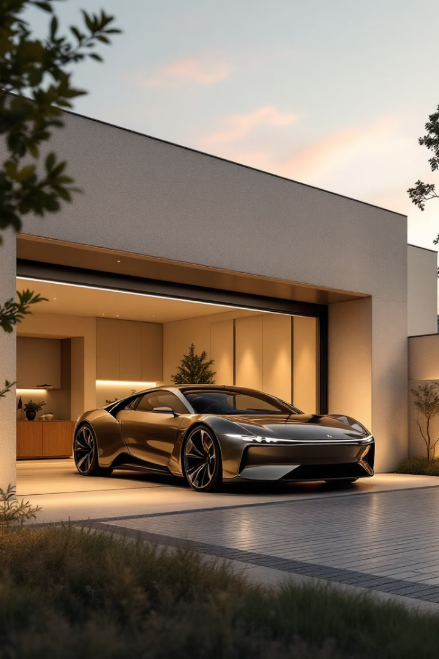
Smart Garage Door Control System
Secure, card-activated garage door system. Industrial-grade safety features. Precise control using LabJack U3.

Slide 2
Project Overview
Problem
Solution
Traditional doors lack security
Card-based authentication
Manual operation is inconvenient
H-bridge motor control
Remote controls are vulnerable
Emergency stop buttons

Slide 3




Project Objectives
Enhanced Security
Improved Safety
Optical sensor activation
Electrical isolation with optocouplers
Fast Performance
<0.2s response time

Slide 4
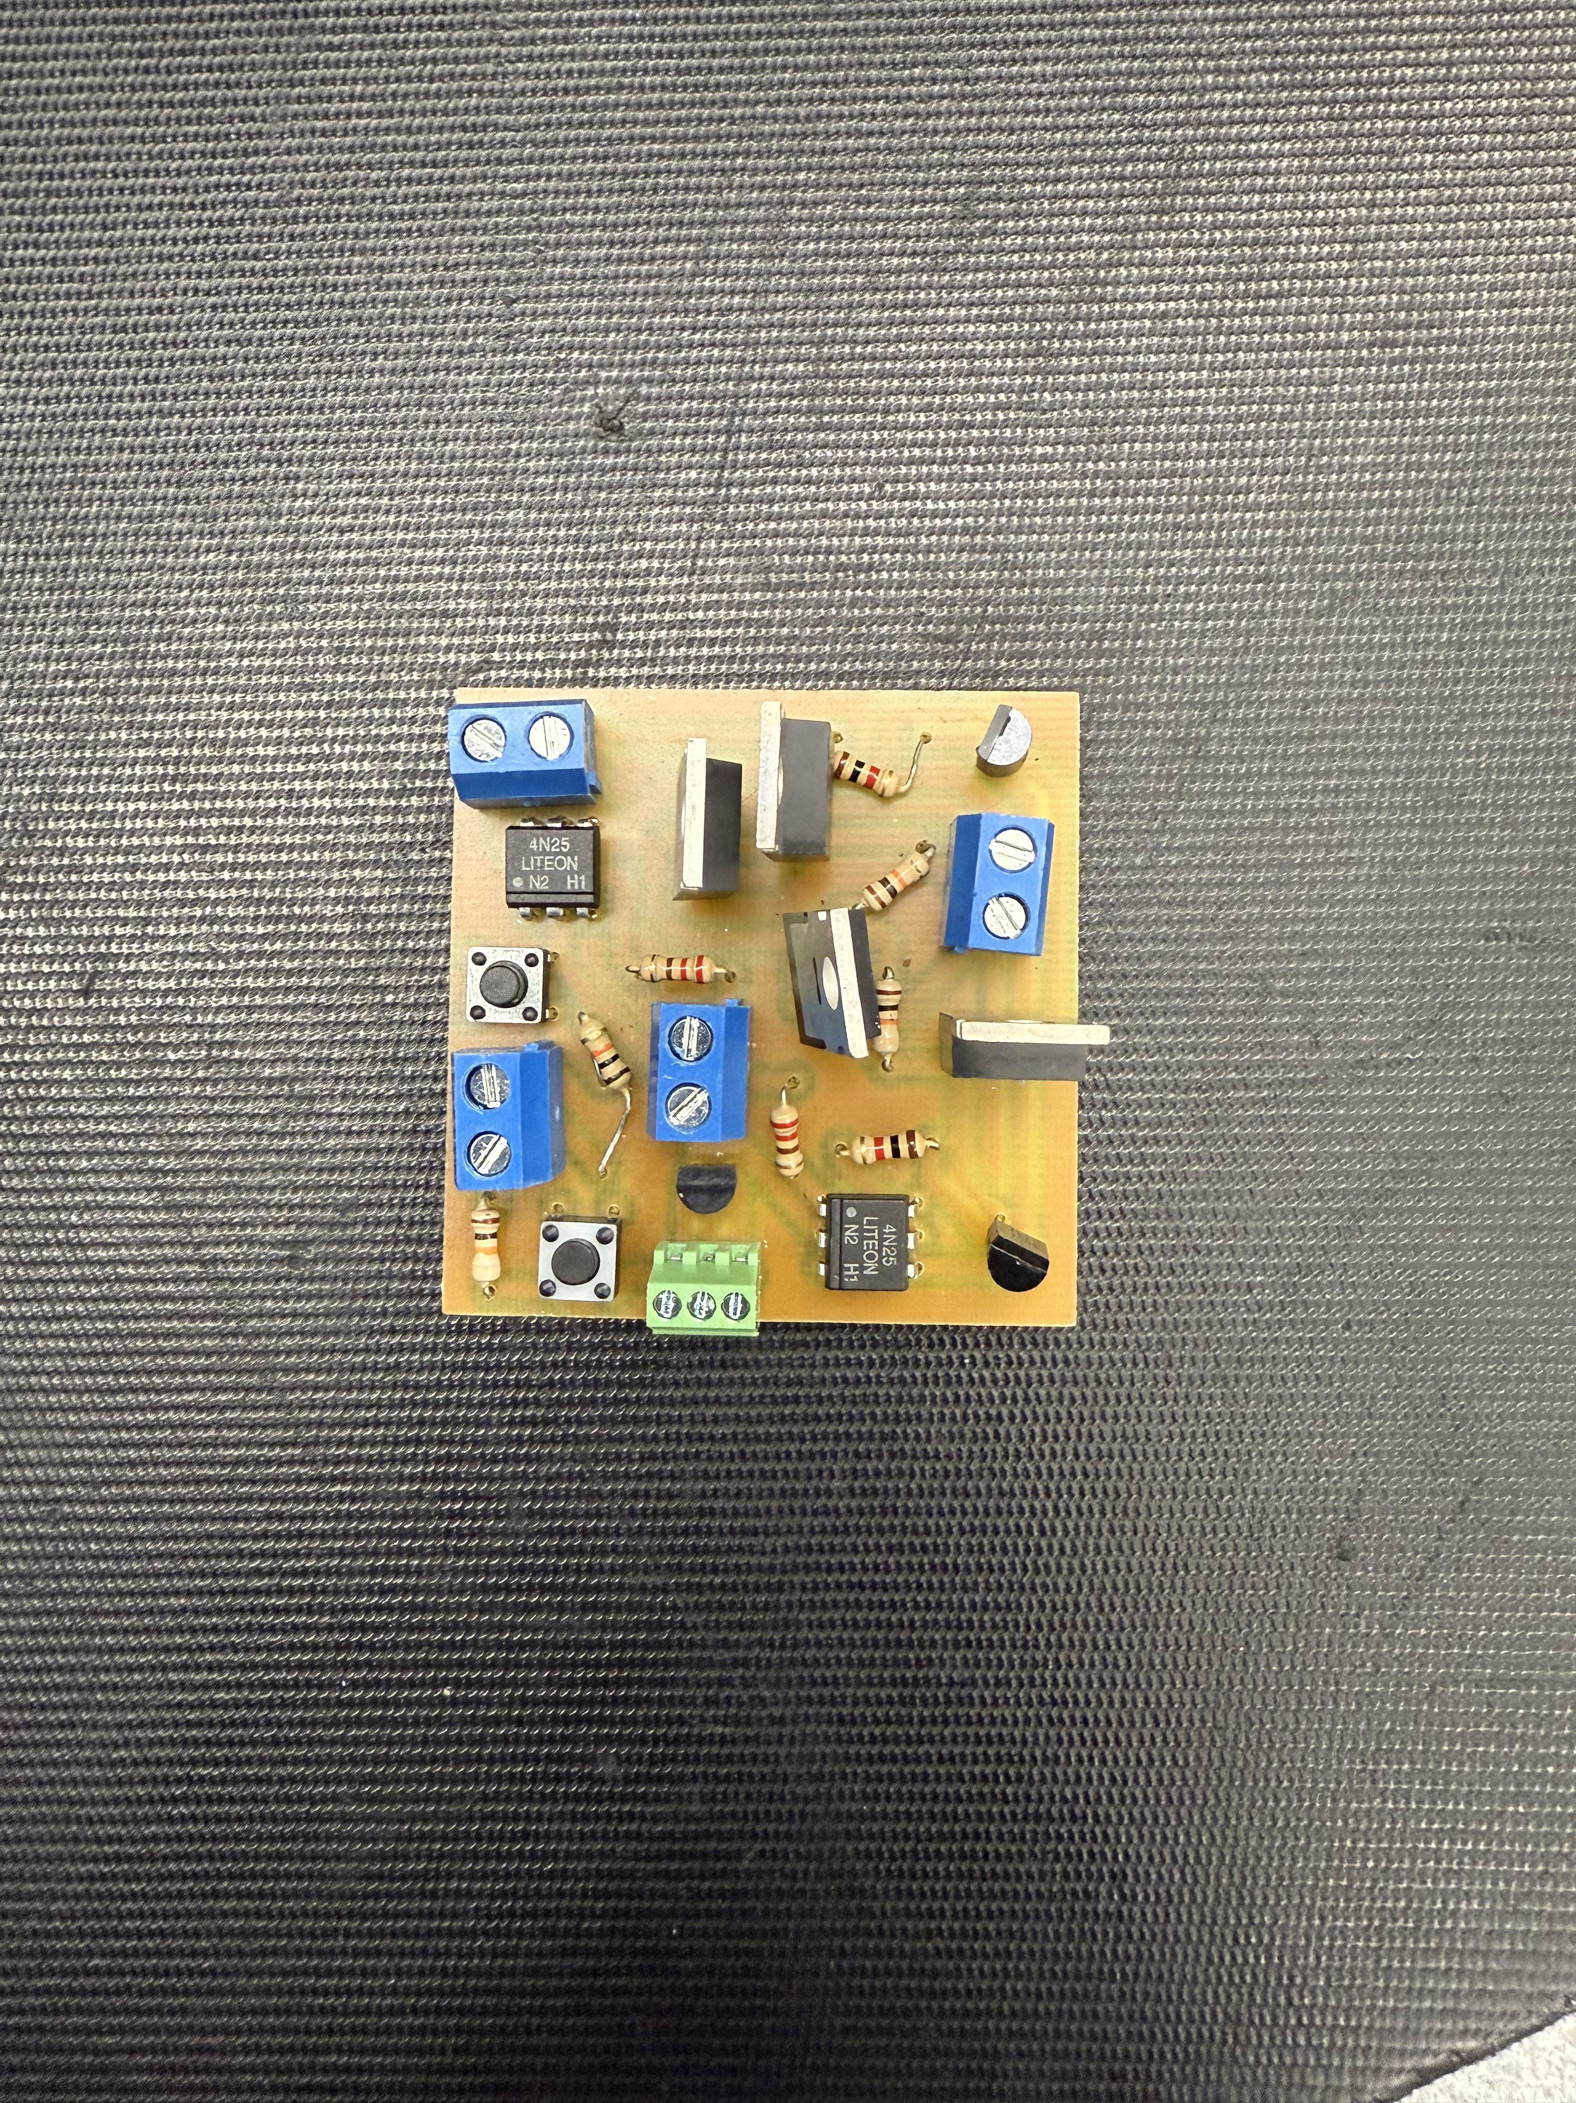
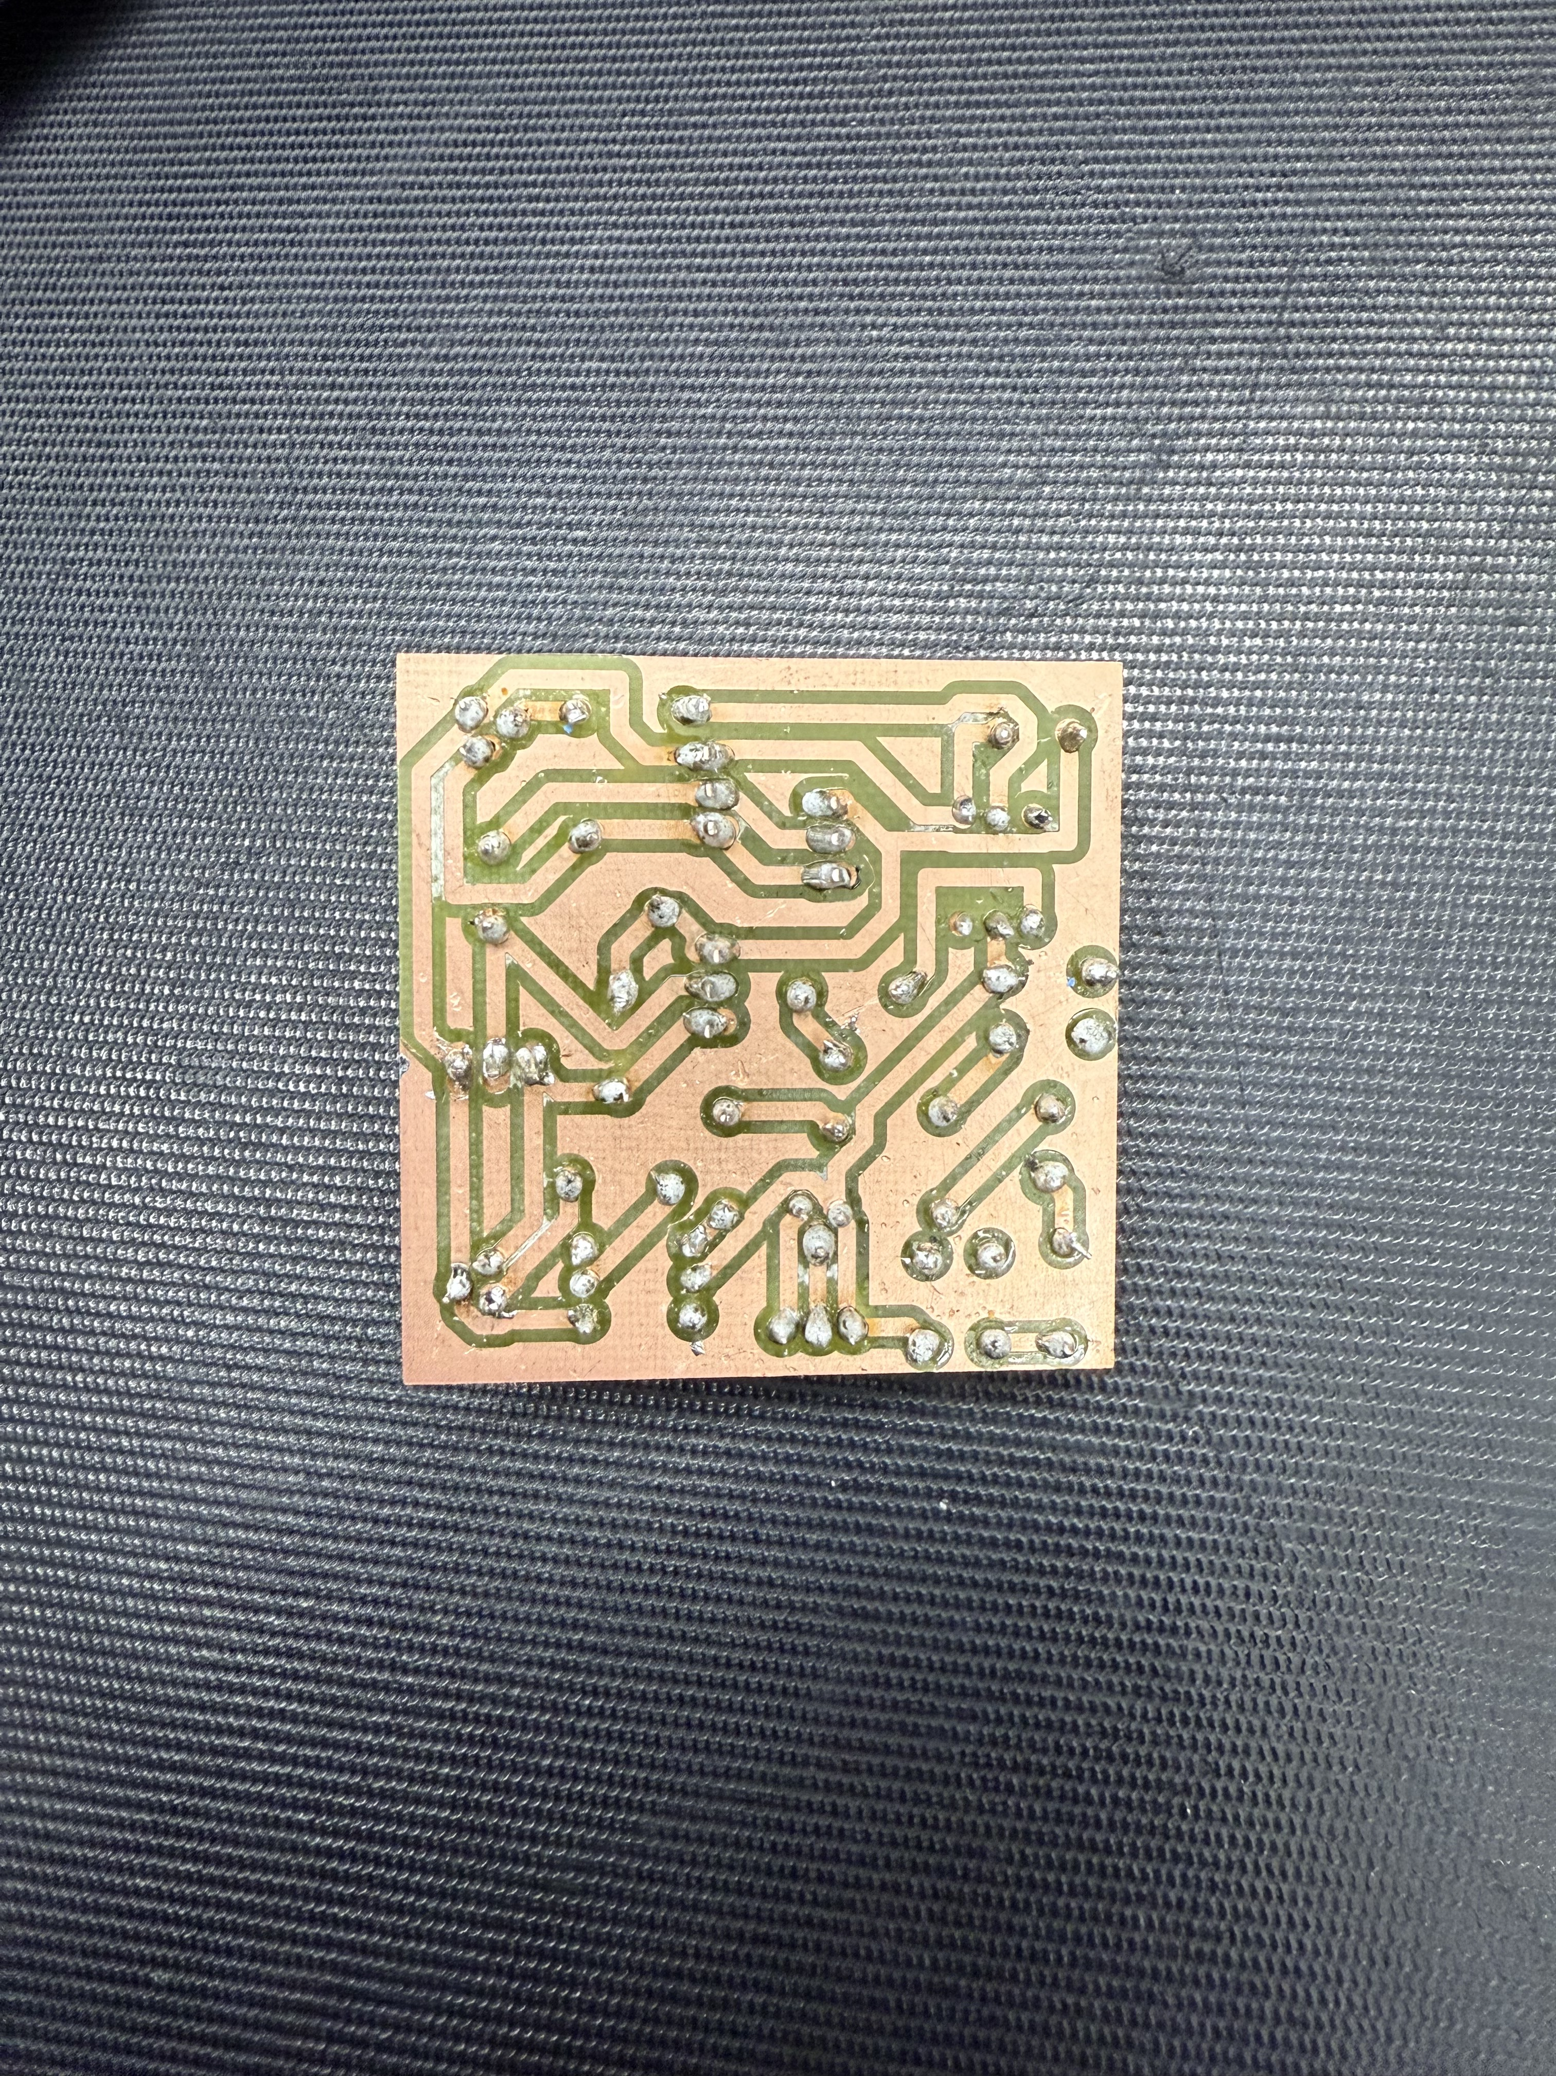
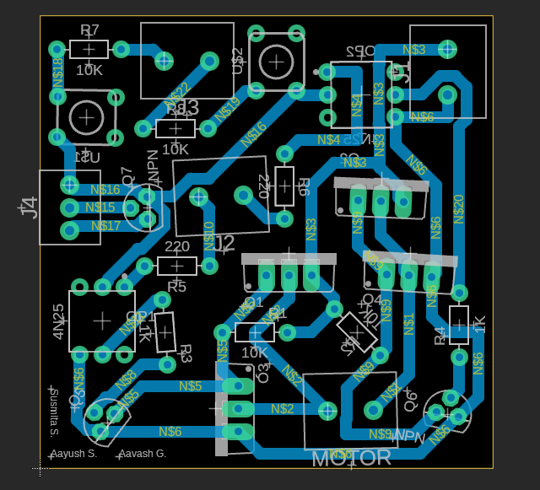
System Components
LabJack U3
Optical Sensor
H-Bridge Circuit
Central control unit
Card detection
Motor control
Optocouplers
Electrical isolation

Slide 5
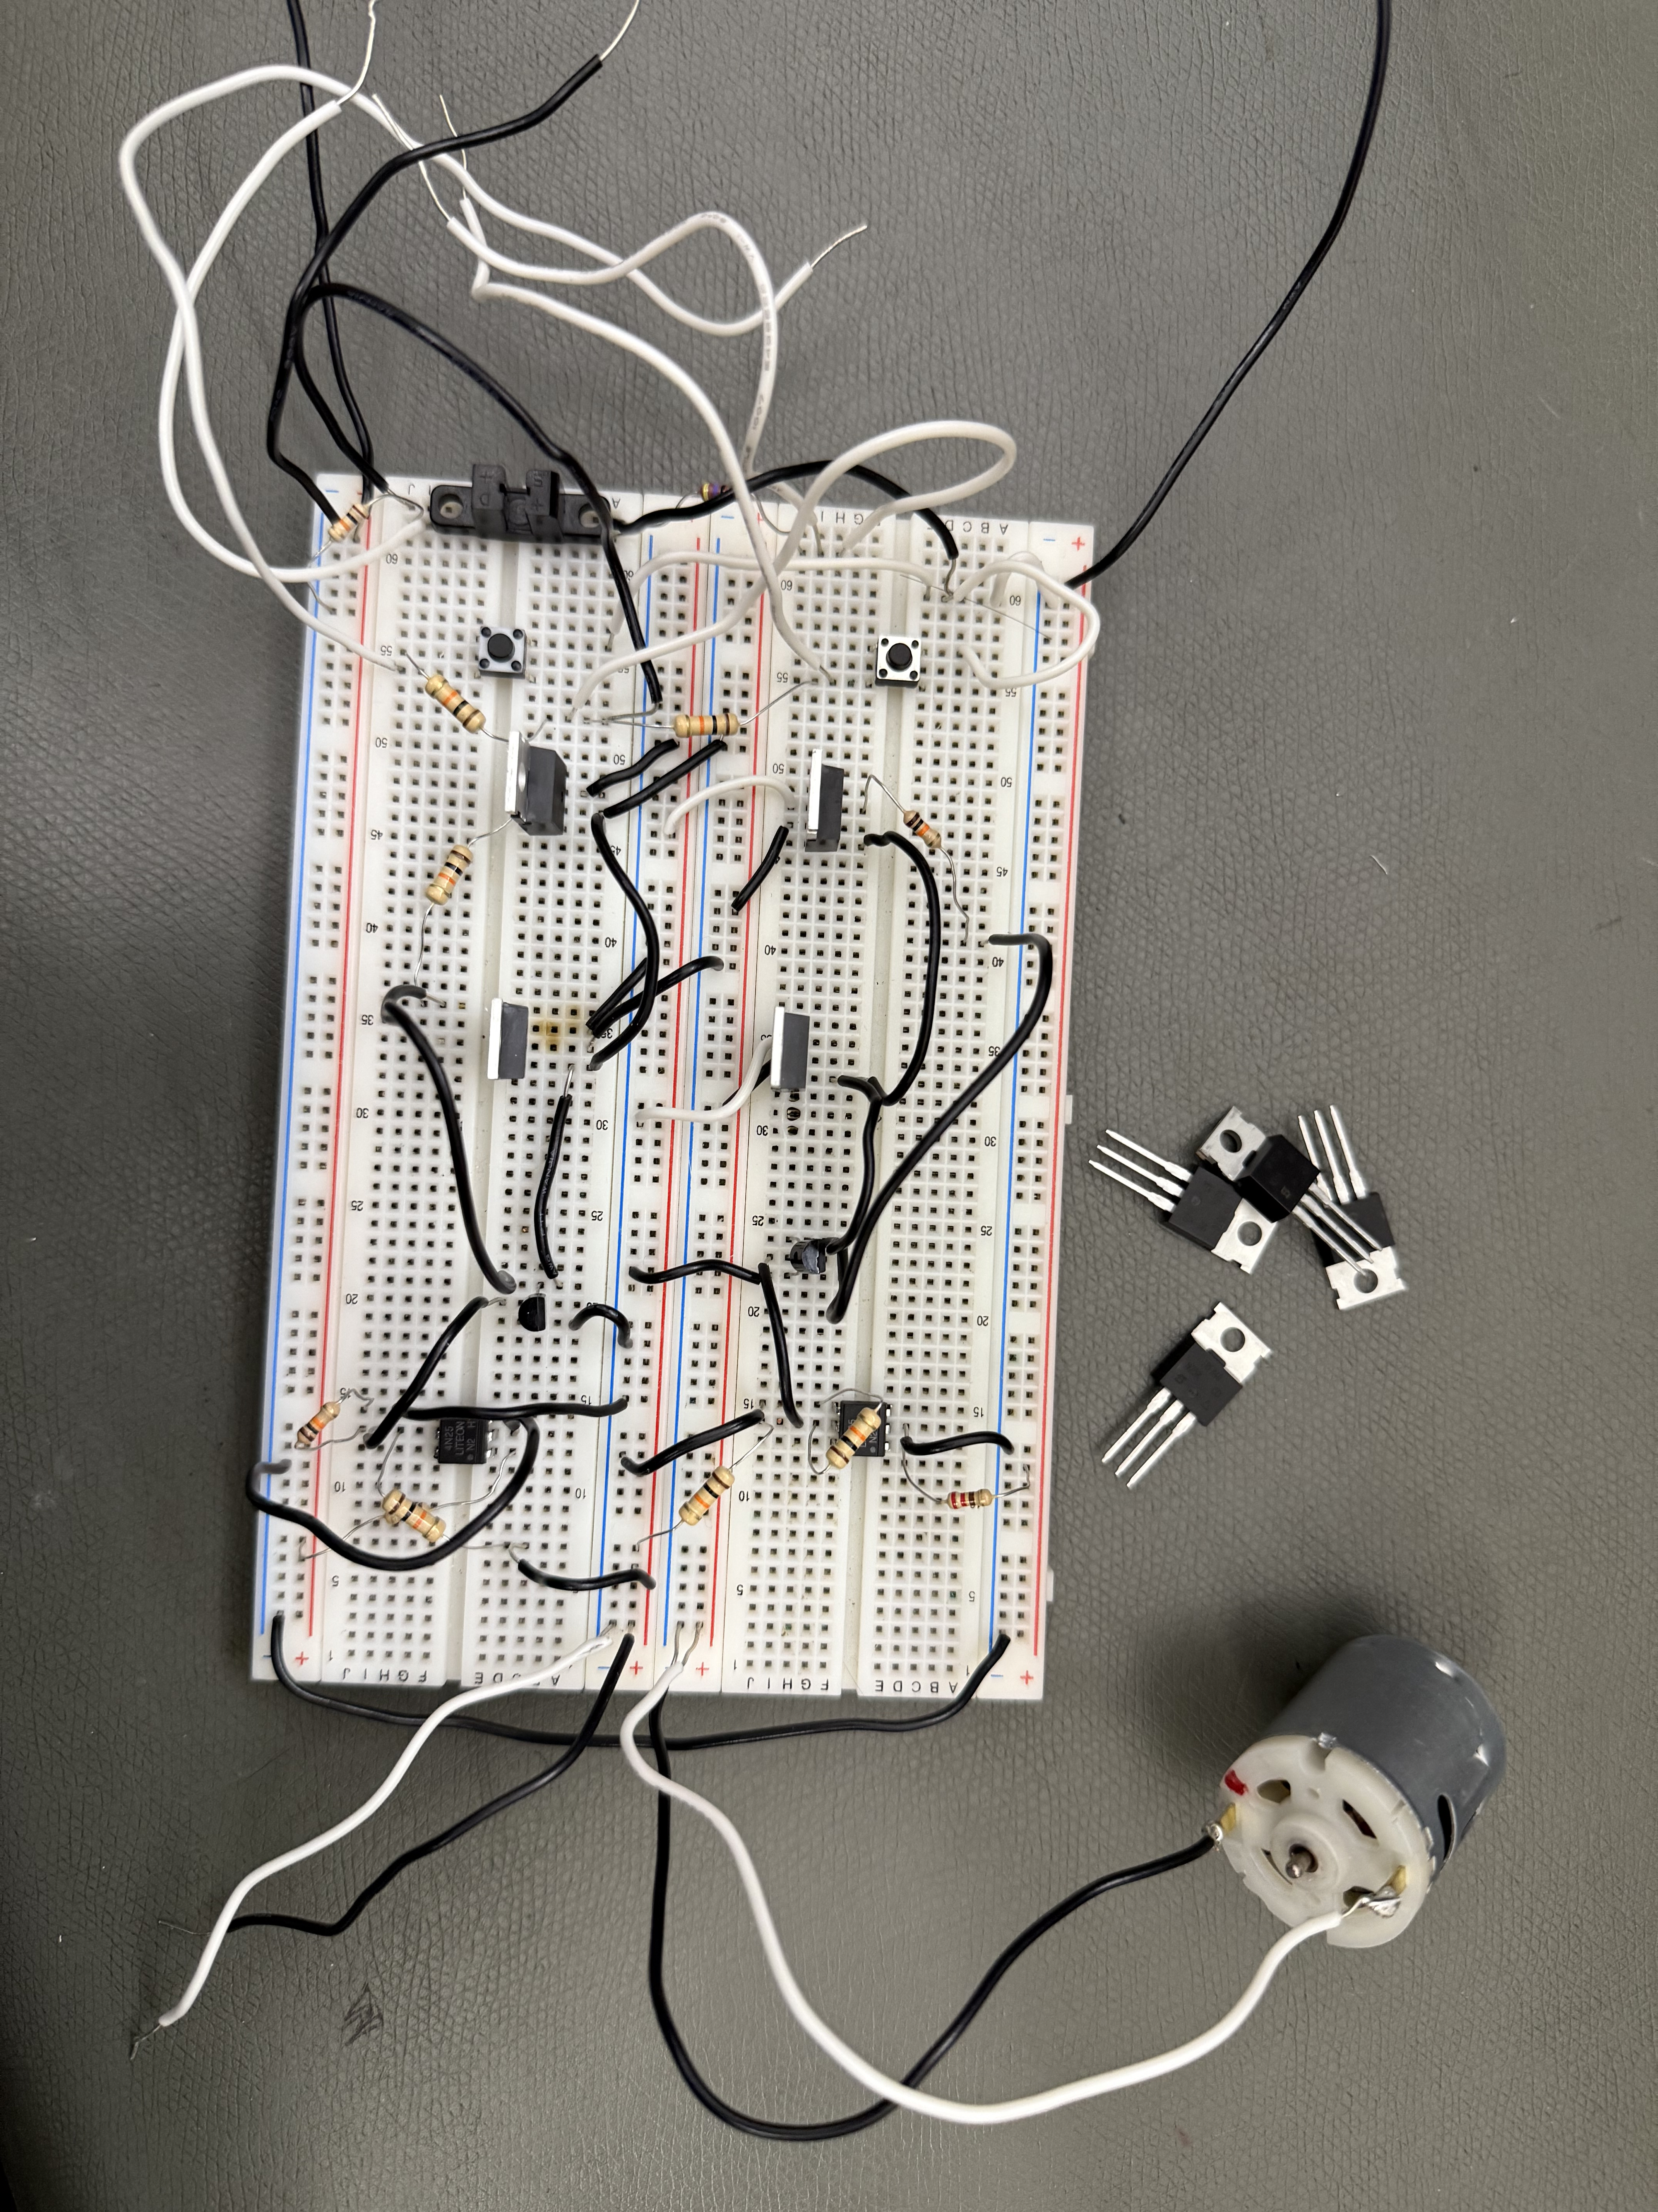
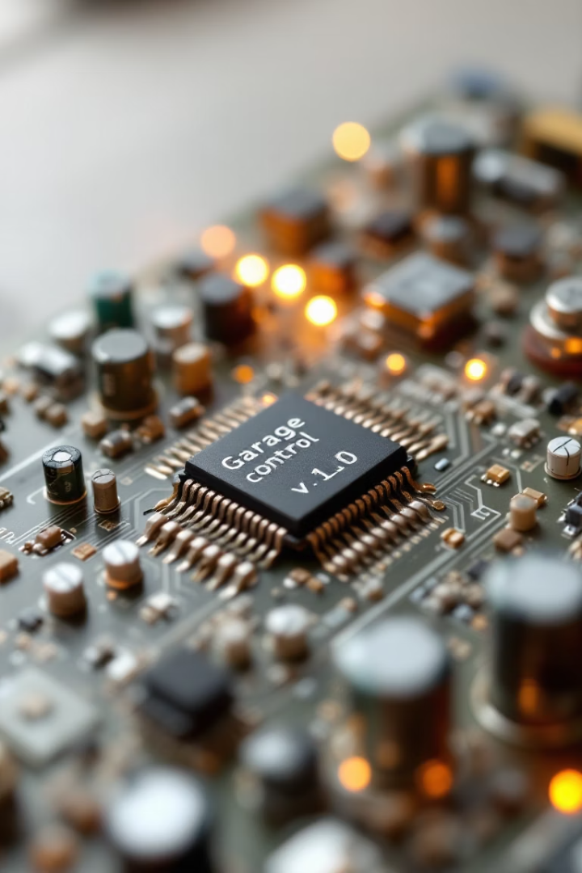


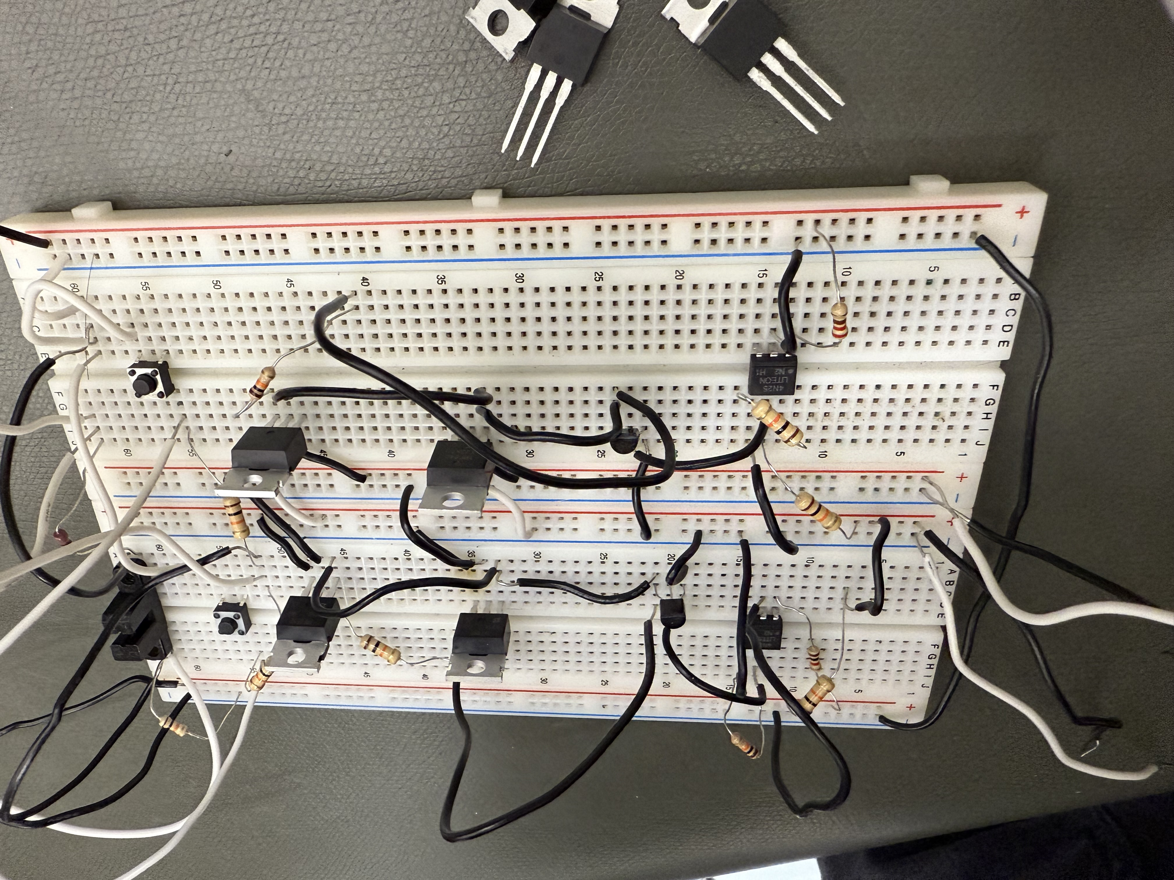

Hardware Implementation
H-Bridge
Bidirectional control
Optocouplers
Voltage spike protection
PCB Layout
Noise reduction

Slide 6



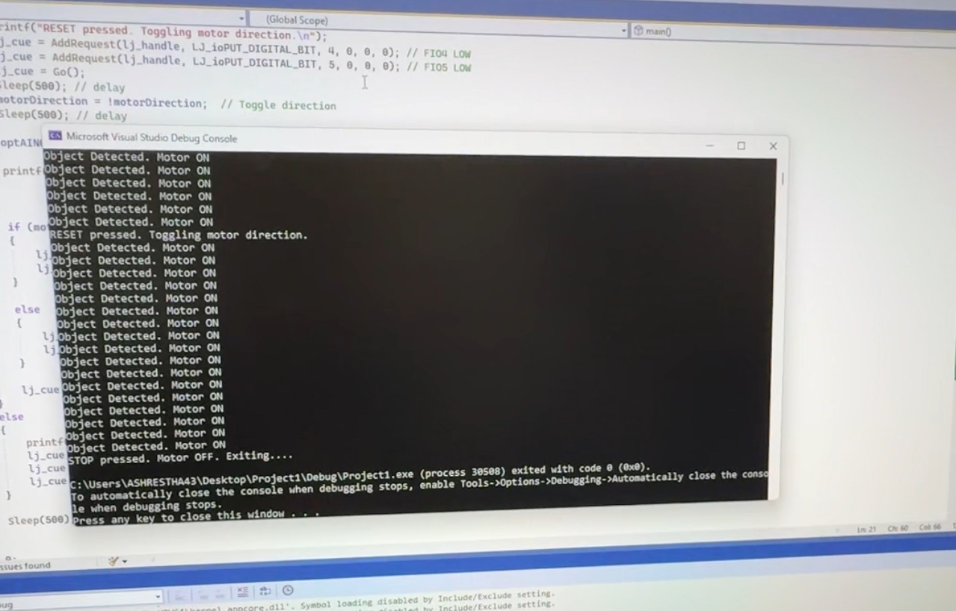

Software Implementation
Control Logic
Poll sensors every 500ms
Motor Control
FIO4/FIO5 outputs
Status Monitoring
Console messages

Slide 7
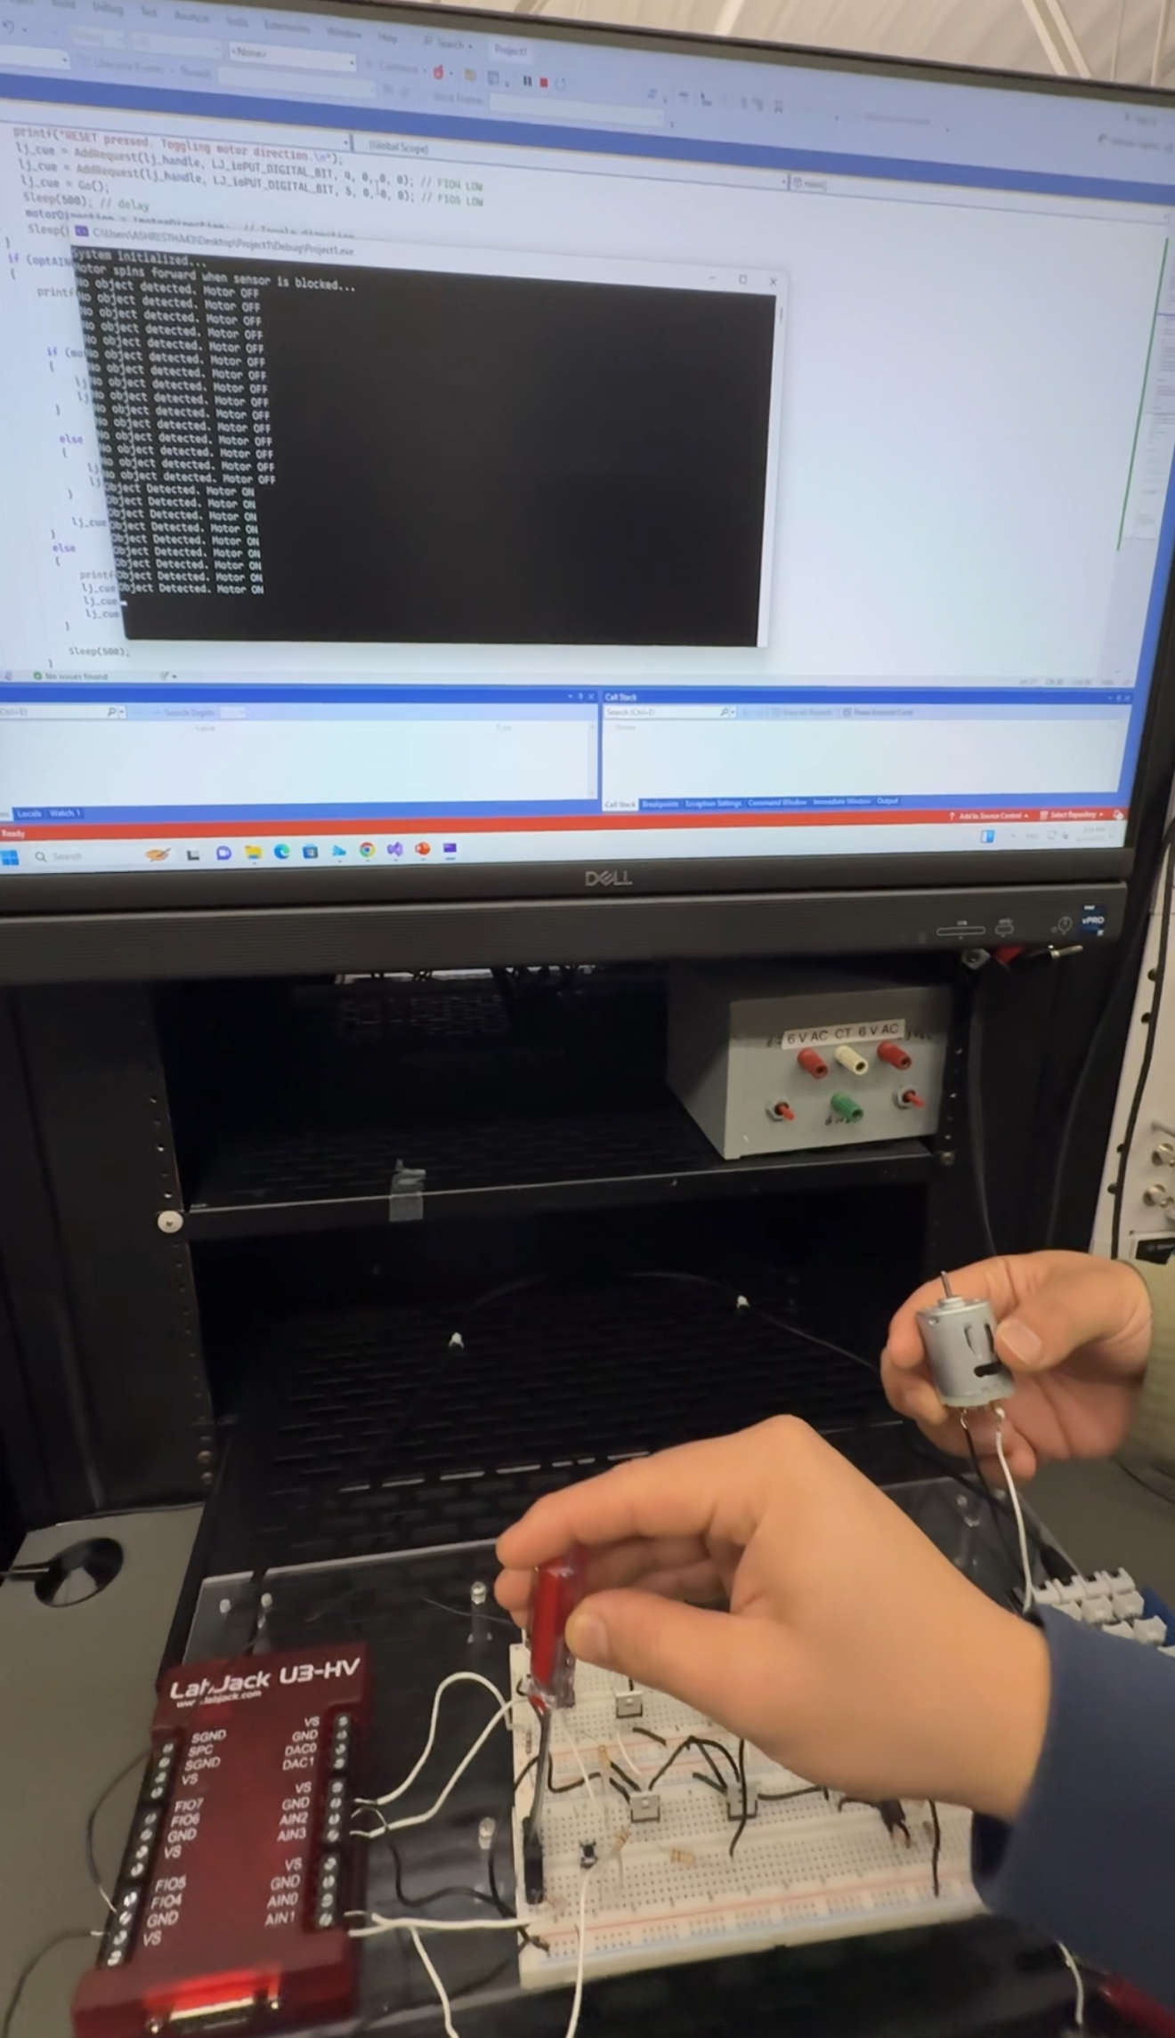
Testing and Performance
500ms
<100ms
Card detection
Emergency shutdown
50V
Isolation blocked spikes
Link to demo video : click here

Slide 8

Future Enhancements
Wireless Control
Voice Integration
Obstacle Detection
Bluetooth/Wi-Fi
Alexa/Google
Infrared/ultrasonic

Slide 9
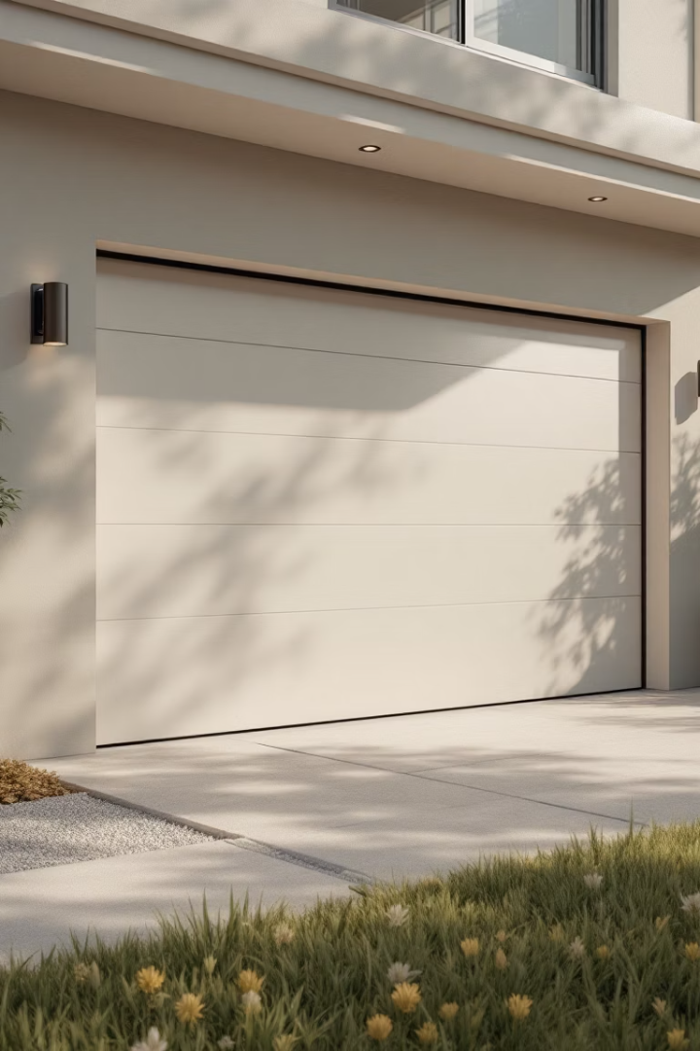
Conclusion
Low Cost
Met Goals
<$150
Speed, safety, isolation
Modular
Supports smart home

Slide 10

Thank You!
Questions?
References: Vishay Siliconix datasheets, LabJack U3 Documentation

